Slide 1

How does a Bike-Share Navigate Speedy Success?
Presented by: Ibrahim Volpi
April 30th, 2022

Slide 2

Table of contents
Objective of this presentation: Casual Riders vs Member Riders
Analysis of the situation: Cyclistic bike-share story through data
Conclusions
Appendix

Slide 3
Objectives

Slide 4
Gain a better understanding on how casual riders differ from member riders based on the data provided by Cyclistic for the last year.
Provide these insights to the marketing and digital media teams to be able to design marketing strategies aimed at converting casual riders to members.

Slide 5
Data Cleaning

Slide 6
Analysis of the situation: Cyclistic bike-share story through data
Data collection: correspondent to rides for casual riders and members in the period between 2021-05-01 and 2022-03-31
Data Preparation - extraction and merge
Merging of the separate files downloaded using SQL queries
Creation of CSV file with all the data correspondent to the period of time aforementioned.
Export of CSV file to Rstudio for data cleaning.

Slide 7
Analysis of the situation: Cyclistic bike-share story through data
Data cleaning – Attributes exploration
The data used is a CSV file with 5,917,935 rows, each row corresponds to one ride and the categories informed on each ride are:
Ride Id. (Alphanumeric unique identificator)
Rideable type (type of bike used, from traditional to ebikes)
Start /End date and time for the ride.
Geographical coordinates at Start and End of the ride
Name of station at start and end of the ride.
Identificator for casual or member rides.

Slide 8
Analysis of the situation: Cyclistic bike-share story through data
Data Cleaning - Attributes preparation and duplication removal.
Elimination of duplicated rows.
Elimination of rows with no End Coordinates.
Transformation of date and time at start and end of the rides.
Creation of different fields for time and date.
Creation of a field for the weekday on each ride.
Calculation of the duration in minutes for the ride.
Calculation of the distance in Km travelled based on geographical coordinates.

Slide 9
Analysis of the situation: Cyclistic bike-share story through data
Data Cleaning - Outliers
Removal of rides with duration less than 5 minutes with start and end on the same station, these rides represent rides where the rider changed their mind and didn’t use the service.
Removal of outlier in terms of distances travelled more than 1000 KM.
Removal of outlier of duration more than 5 hours, based on maximum distance travelled.
Removal of wrong data collected, with arrival time before departure time.
Removal of rides with no end or start station identification.

Slide 10
Data Story

Slide 11
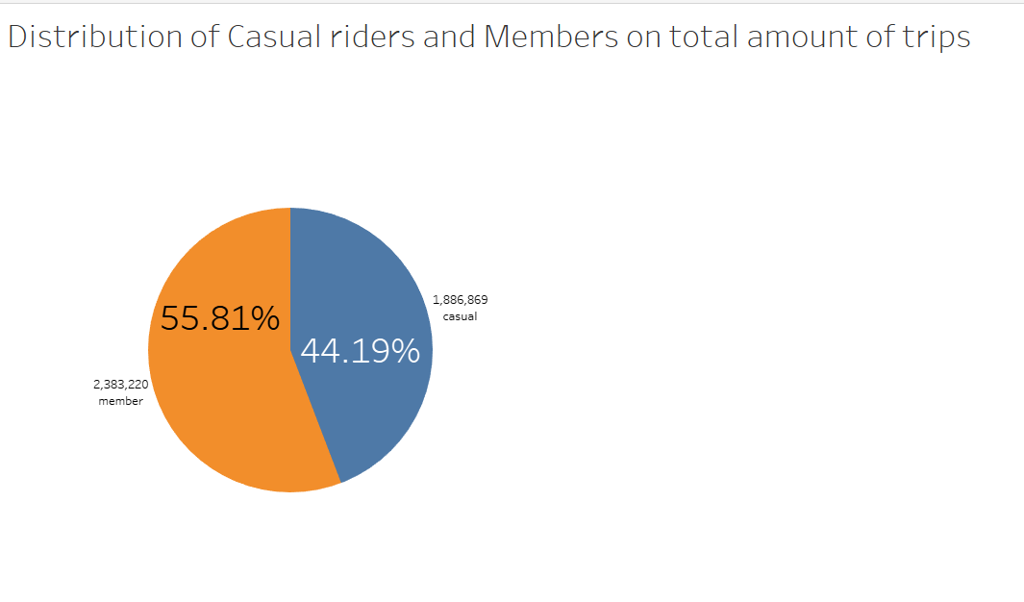
The distribution of casual and member rides is similar, with more member rides than casuals.
Cyclist's finance analysts have determined that annual members are much more profitable than casual riders.

Slide 12
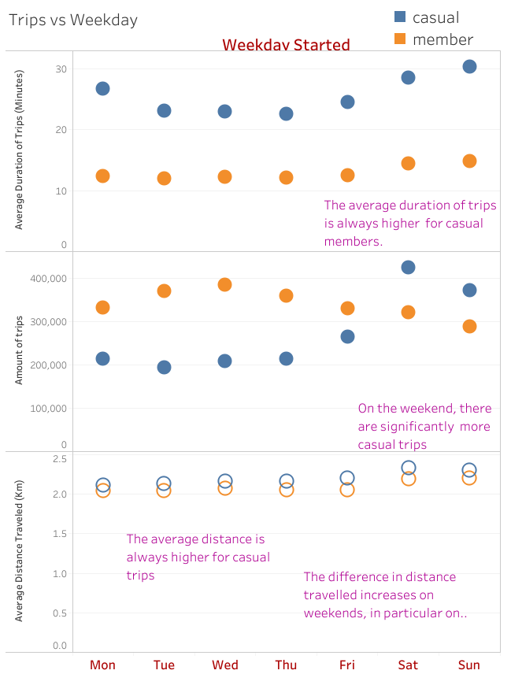
Average duration:
between 10 to 35 minutes, with durations for members lower than casuals.
Average duration of trips is higher on weekends for both casual and members.
There are more casual trips on weekends than member trips.
More distance travelled on rides on weekends

Slide 13
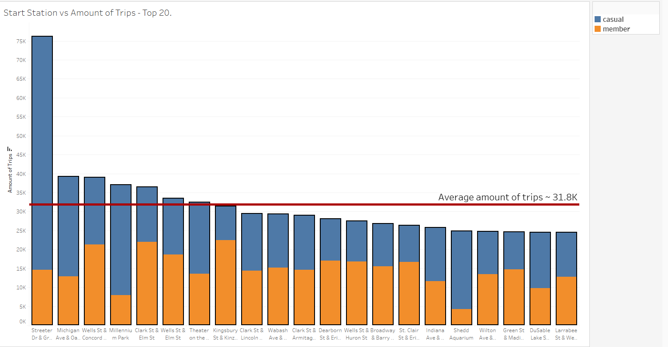
Three of the top five stations in terms of rides have majority of casual rides.

Slide 14
Conclusions

Slide 15
Conclusions
Majority of revenue is collected from member users, which have lesser average time and distance travelled on their rides than casual riders.
On weekends, there is an increase on casual rides with longer duration and distance travelled.
On weekends, there are more casual rides than member rides

Slide 16
1,2,3…Action!

Slide 17
Actions
To promote conversion from casual riders to members several actions may be taken from the marketing and digital media areas:
Targeted campaign to promote free membership trials for casual riders who ride on weekends. This may be for example a few months under member rate per month or three times the average revenue from casual riders per weekend as a fixed fee for a few months.
Support on the riders app for casual riders offering stats of costs, ride duration and distance travelled, comparing with the costs for members.
Visual ads for promotions of conversion from casual to members on at least the top 20 stations analysed.
Provided the revenue and repitance of casual rides, better estimations of promotions and conversions may be established.

Slide 18
Appendix

Slide 19
Useful links:
Link for source data: https://bit.ly/3OPQ75K
Link to CSV file after merging: https://bit.ly/3F63uKr
Link to the Journal for data acquisition and data cleaning: https://bit.ly/3Lzbfev
Link to CSV file after cleaning: https://bit.ly/3Lzbfev
Link to Github repository: https://bit.ly/3vWquri

Slide 20
Thank you!

